Slide 1
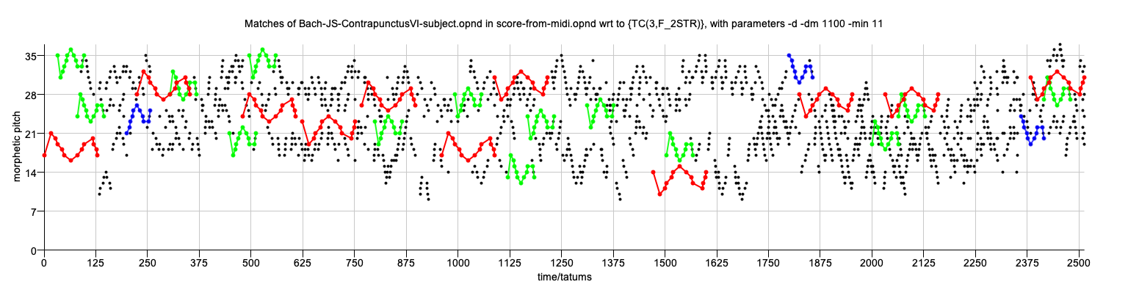
A parallel, geometric algorithm for transformed pattern matching in polyphonic music
David Meredith
Aalborg University, Denmark
dave@create.aau.dk

Slide 2
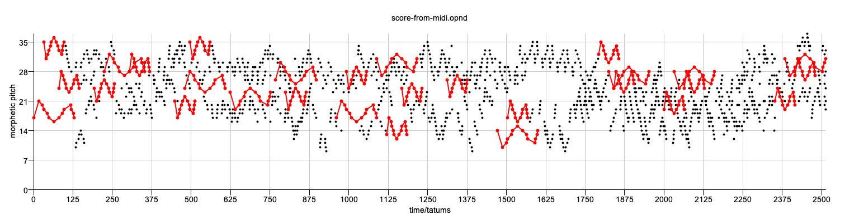
The problem
The problem we address is that of discovering possibly transformed, maximal occurrences of a query pattern in a dataset, where the pattern can be transformed by some user-specified class of transformations

Slide 3
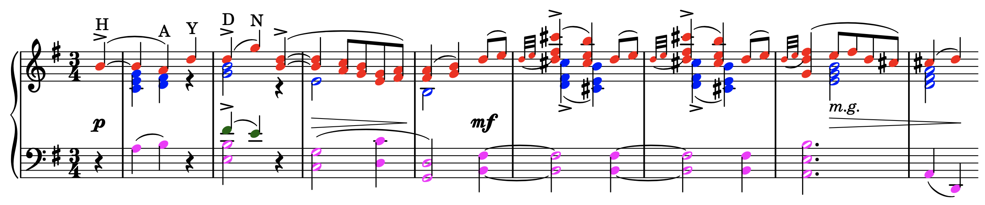
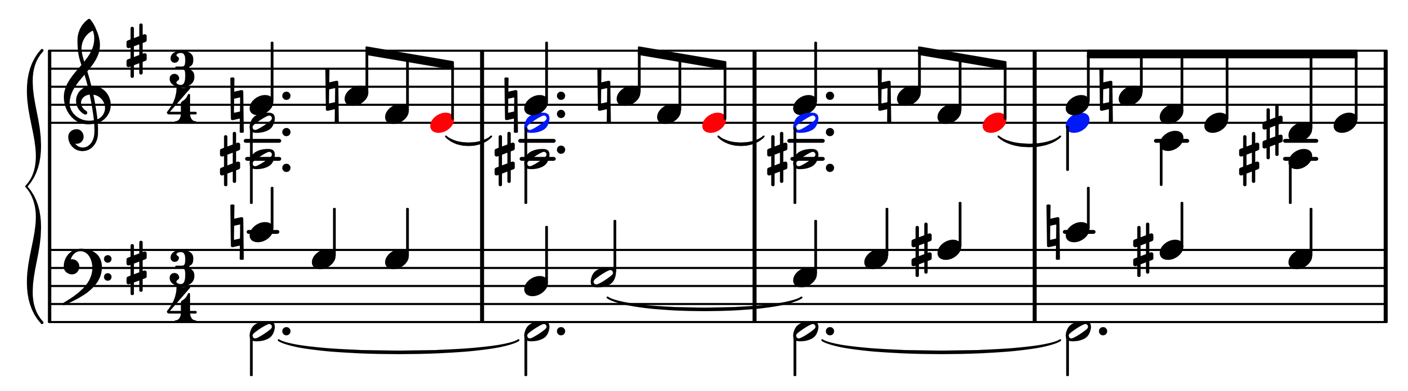
Unvoiced polyphonic music
We're particularly interested in the case where neither the query pattern nor the dataset can be unambiguously partitioned into voices or parts
As is often the case in keyboard music – see examples above
We adopt a geometric approach, where each note is represented as a point, as this does not require the music to be represented as a set of voices

Slide 4
Maximal transformed matches
D
Q
Suppose we have a query pattern, Q, and a dataset, D, both of which are sets of k-dimensional points
We define a transformation, f, to be a bijection over the universe of k-dimensional points
A transformation is therefore a function with a unique inverse that maps a k-dimensional point onto a k-dimensional point
The maximal transformed match (MTM) (or simply maximal match) of Q in D for the transformation, f, is the intersection of D and f(Q)

Slide 5
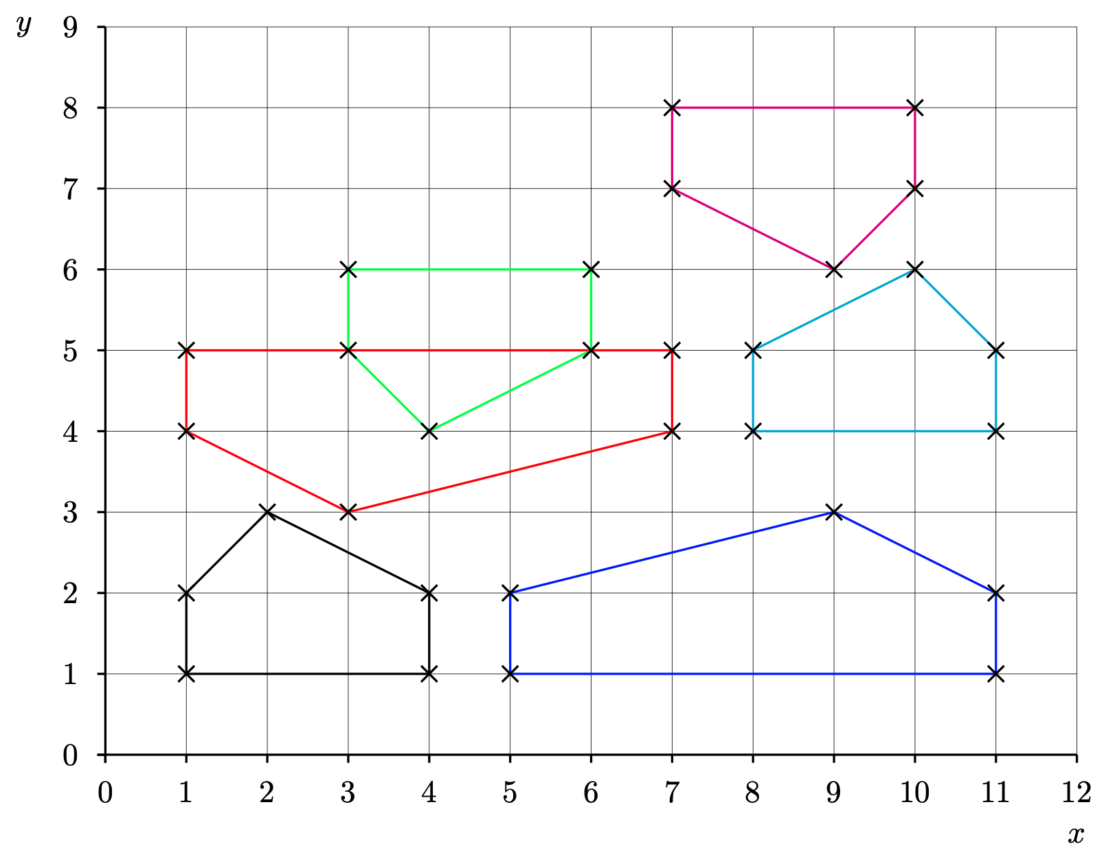
User-specified transformation classes
We adapt a framework developed for pattern discovery to pattern matching¹
This framework allows users to specify the class (or classes) of transformations that they are interested in
If the dataset is k-dimensional, then the transformation class must be a set of bijections over the universe of k-dimensional points
We present a parallel algorithm that takes a query pattern, Q, a dataset, D, and a transformation class, F, and discovers all maximal matches of Q in D with respect to F
1. Meredith, D.: Understanding and compressing music with maximal transformable patterns. LNCS 14035, 309–325 (2023), https://link.springer.com/chapter/10.1007/978-3-031-34732-0_24

Slide 6
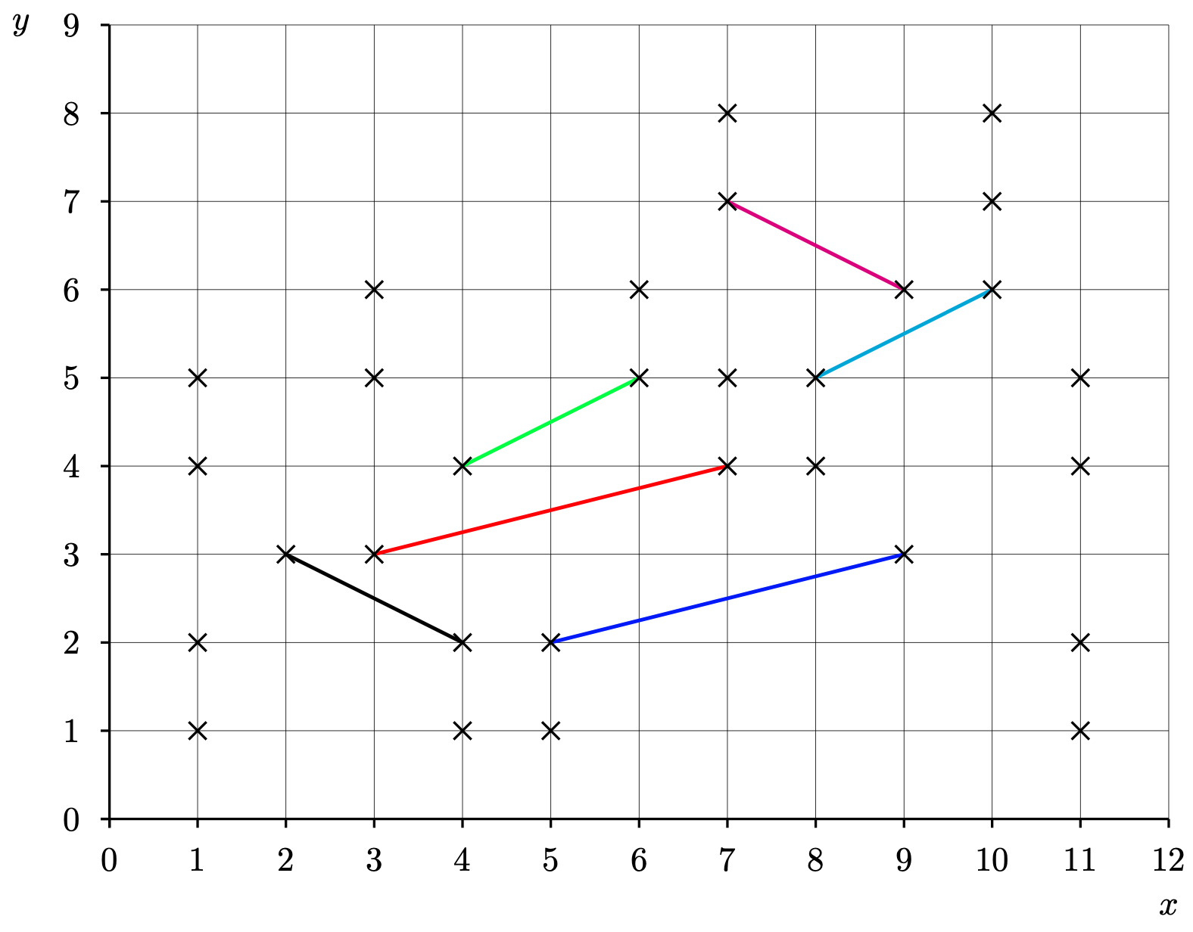
Example transformation class: F_{2STR}
F_{2STR} contains all transformations consisting of a scaling parallel to the the x-axis, followed by a translation and then optionally followed by a reflection in the x-axis
If our dataset is a pitch-vs-time representation of some music, then F_{2STR} contains the transformations corresponding to the traditional musical contrapuntal transformations of transposition, inversion, retrograde, diminution and augmentation
We can identify each transformation in F_{2STR} by a transformation parameter, (s,v,b), where
s is the scale factor by which the x-coordinate is stretched
v is the vector by which the point is translated
b indicates whether or not the point is reflected in the x-axis
e.g., mapping black line to red line could be achieved using the following transformation parameters:
(-2,(11,1),1)
(2,(-1,-6),-1)

Slide 7
Discovering inter-basis transformations
If we take two ordered pairs of points in a point set, (p1,p2) and (p3,p4), then there are at most two distinct transformations in F_{2STR} that map (p1,p2) onto (p3,p4) and we can define a function that discovers these transformations given (p1,p2) and (p3,p4)
Compare this with the case of F_{2T ,} computed by the SIA algorithm,² which contains all 2-dimensional translations. In this case,
each instance of a transformation in F_{2T} can be represented by a single 2-d vector
given a pair of points, p1 and p2, there is a unique translation that maps p1 onto p2
2. Meredith, D., Lemström, K., Wiggins, G.A.: Algorithms for discovering repeated patterns in multidimensional representations of poly- phonic music. Journal of New Music Research 31(4), 321–345 (2002), https://doi.org/10.1076/jnmr.31.4.321.14162

Slide 8
Basis pairs
Suppose we have
a dataset, D, and a transformation class, F
two ordered sets of points in D, P and Q, each of size 𝛽, such that there is at least one transformation in F that maps the points in P onto corresponding points in Q
Then, for F, we can choose a basis size, 𝛽, which is just large enough so that there is a manageably small maximum number of distinct transformations in F that map P onto Q
so for F_{2STR}, 𝛽=2, whereas for F_{2T}, 𝛽=1
We call P and Q an image basis and object basis, respectively

Slide 9
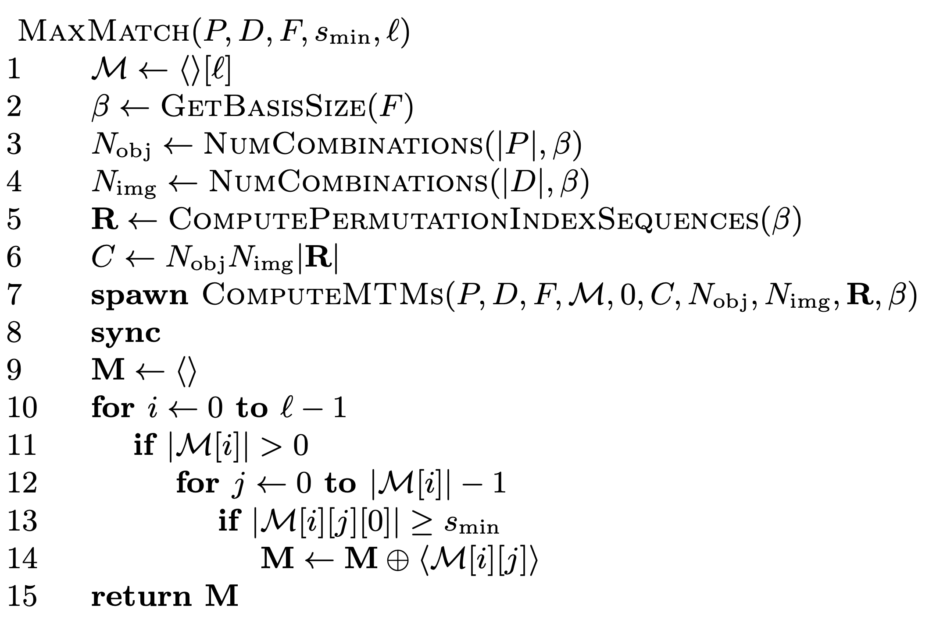
The algorithm
The algorithm first constructs a hash table (line 1)
Each element in this hash table is a list of (f,Q) pairs, in each of which f is a transformation and Q is a point set that eventually becomes the maximal transformed match for f

Slide 10
The algorithm
In lines 2-8, the MTMs of P in D wrt F are computed in parallel using the kernel function, ComputeMTMs

Slide 11
The algorithm
ComputeMTMs needs to be provided with the basis size and the total number of object bases and image bases, which are equal to the number of combinations of size equal to the basis size in the pattern P and dataset D, respectively
In line 5, the set of permutations of the sequence from 0 to beta - 1 is computed and stored in lexicographical order in R
The basis size is typically very small, so its factorial will also typically be small
ComputeMTMs is called on an new thread with its start and end indices set to 0 and C, the total number of computations (line 6)

Slide 12
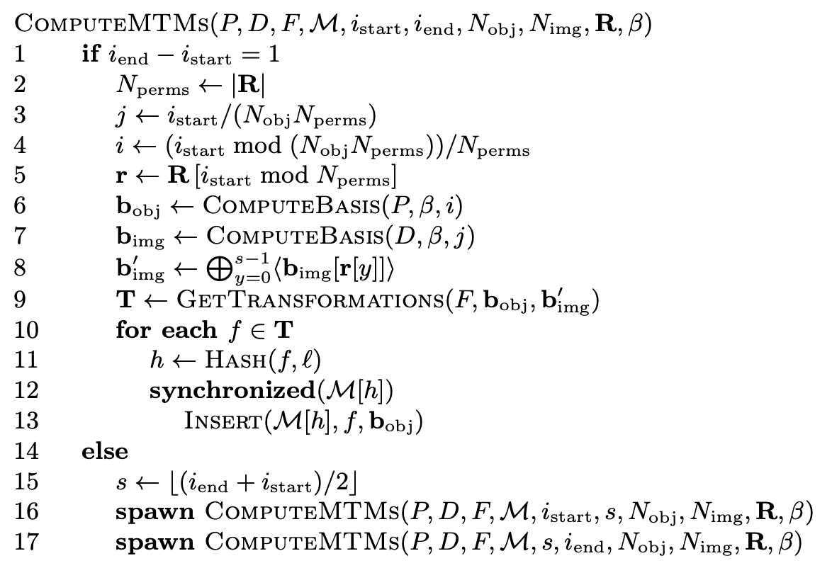
The algorithm
ComputeMTMs is a recursive kernel function that is always run on its own thread
When the base case occurs, a specific object basis from P is chosen along with a specific permutation of a specific image basis from D
The transformations that map the object basis onto that permutation are computed in line 9

Slide 13
The algorithm
In lines 10-13, we iterate over the discovered transformations, computing their hash values and inserting an (transformation, object-basis) pair into the hash table
If there already exists a pair with the same transformation at the hash slot, then the object basis points are added to that pair's second element, otherwise the pair is added as a new pair to the slot
In the recursive case, the range from i_{start} to i_{end} is split in two and each subrange is passed to newly spawned instances of ComputeMTMs which run in parallel

Slide 14
The algorithm
When all parallel calls to ComputeMTMs have terminated in line 8 of MaxMatch, the MTMs are harvested from the hash table and stored in a list which is returned.

Slide 15
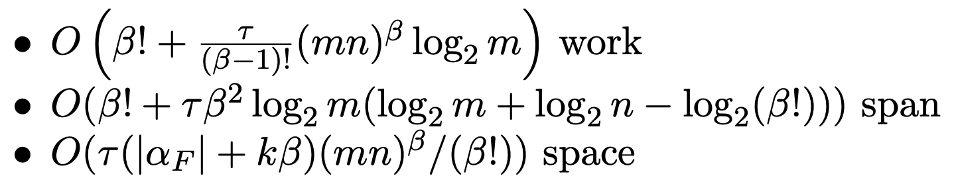
Work, span and space complexity

Slide 16
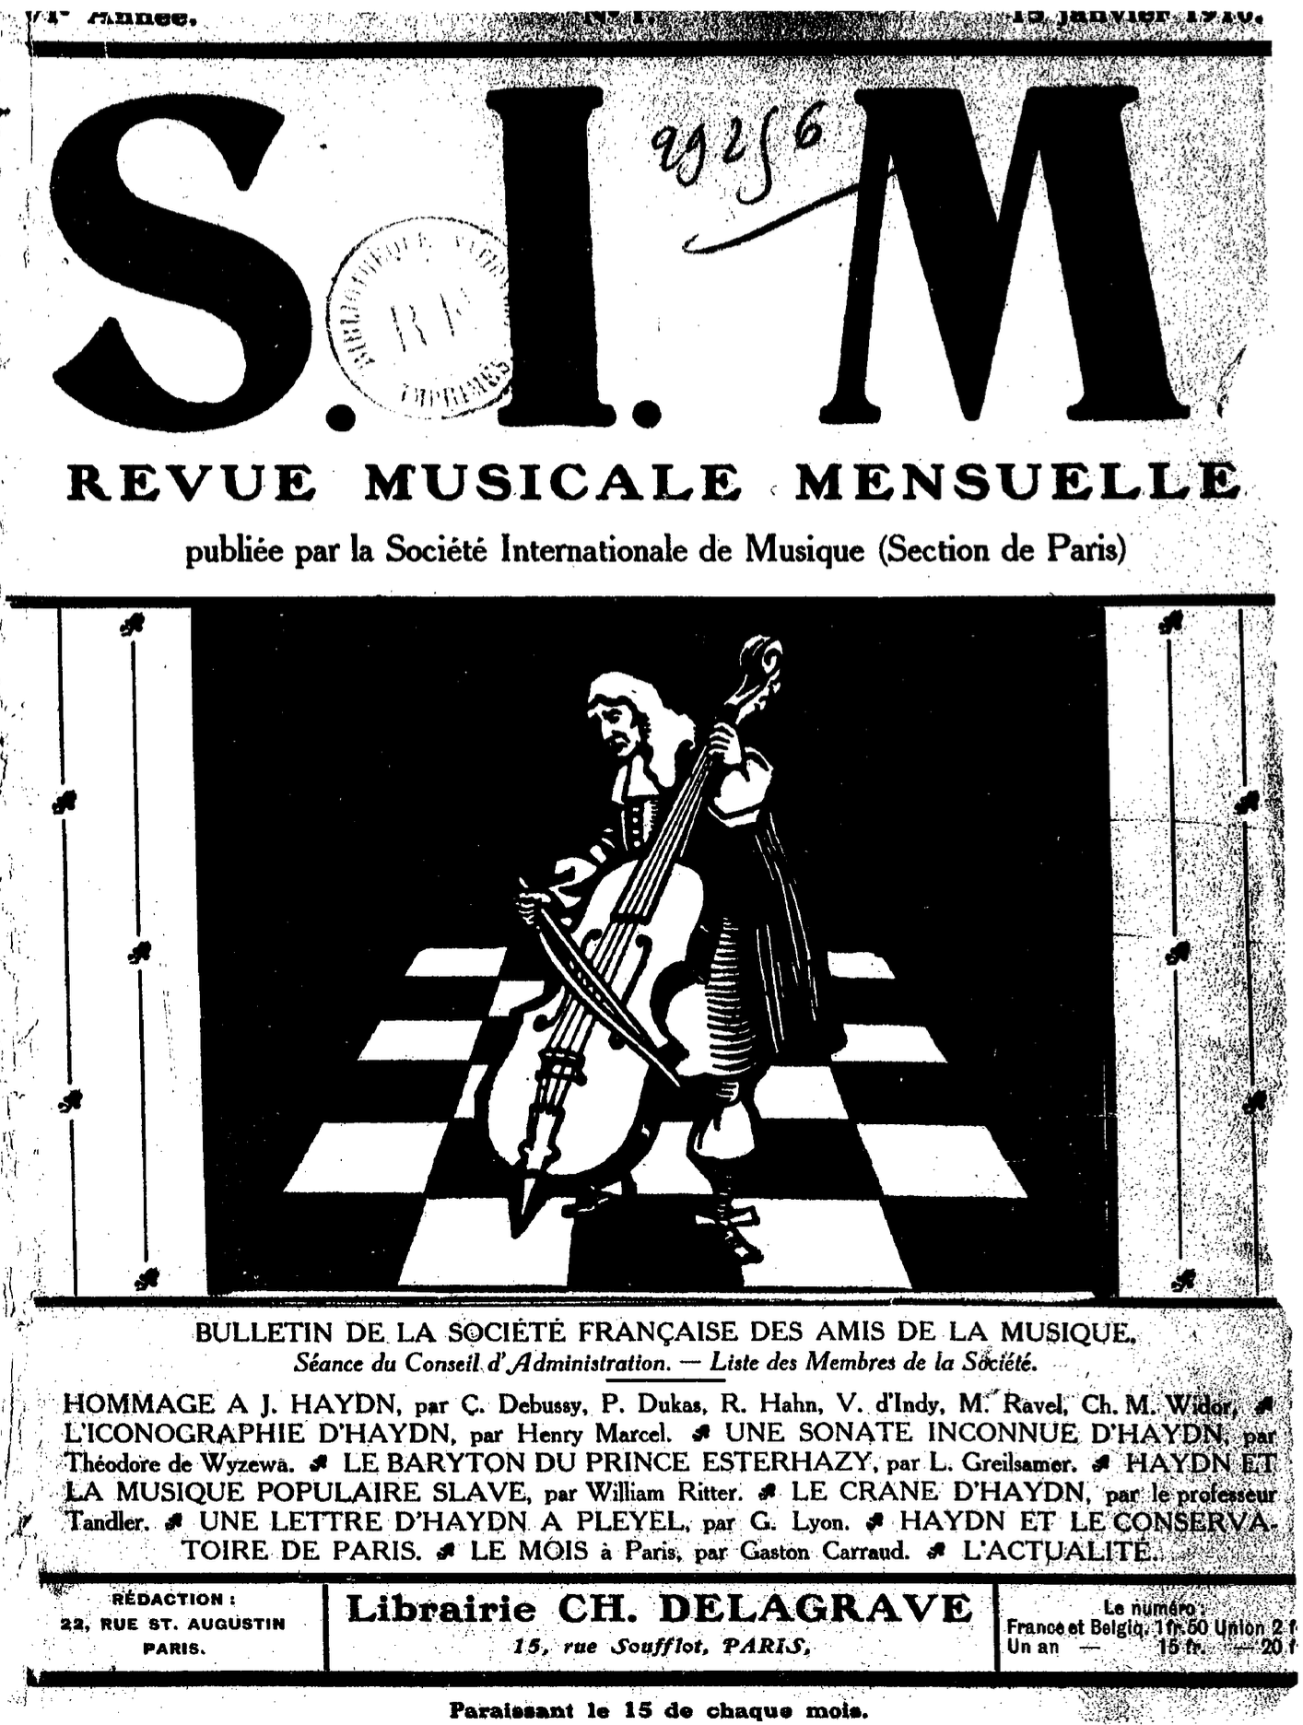
Hommage à Joseph Haydn
In 1909, the Revue musicale mensuelle de la Société Internationale de Musique (RSIM) requested six of the most prominent French composers of the time to write a piano piece incorporating a theme encoding the word, "HAYDN", on the occasion of the 100th anniversary of Joseph Haydn's death
The six composers were Claude Debussy (1862–1918), Paul Dukas (1865–1935), Vincent d’Indy (1851–1931), Reynaldo Hahn (1874–1947), Charles-Marie Widor (1844–1937) and Maurice Ravel (1875–1937)
The six pieces were published in a special issue of the RSIM on15 January 1910, under the title, "Hommage à Joseph Haydn"

Slide 17
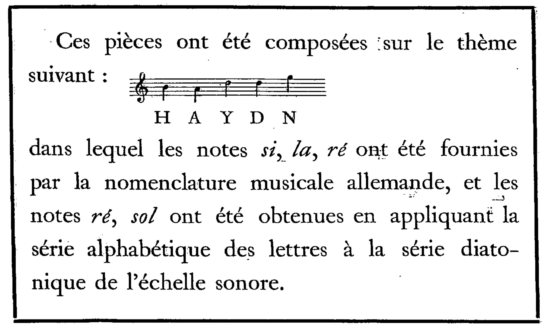
The "HAYDN" theme
This "Hommage" is preceded by an explanatory note, shown on the left, written by the editor of RSIM, Jules Écorcheville
The note states that the pieces were "composed on the theme" shown, which is simply the sequence of 5 notes, B-A-D-D-G
"H" in the German pitch-naming system corresponds to B natural, and the first D in the theme represents the letter Y as a result of cyclically mapping the sequence of pitch letter names, A-G, onto the letters of the alphabet

Slide 18
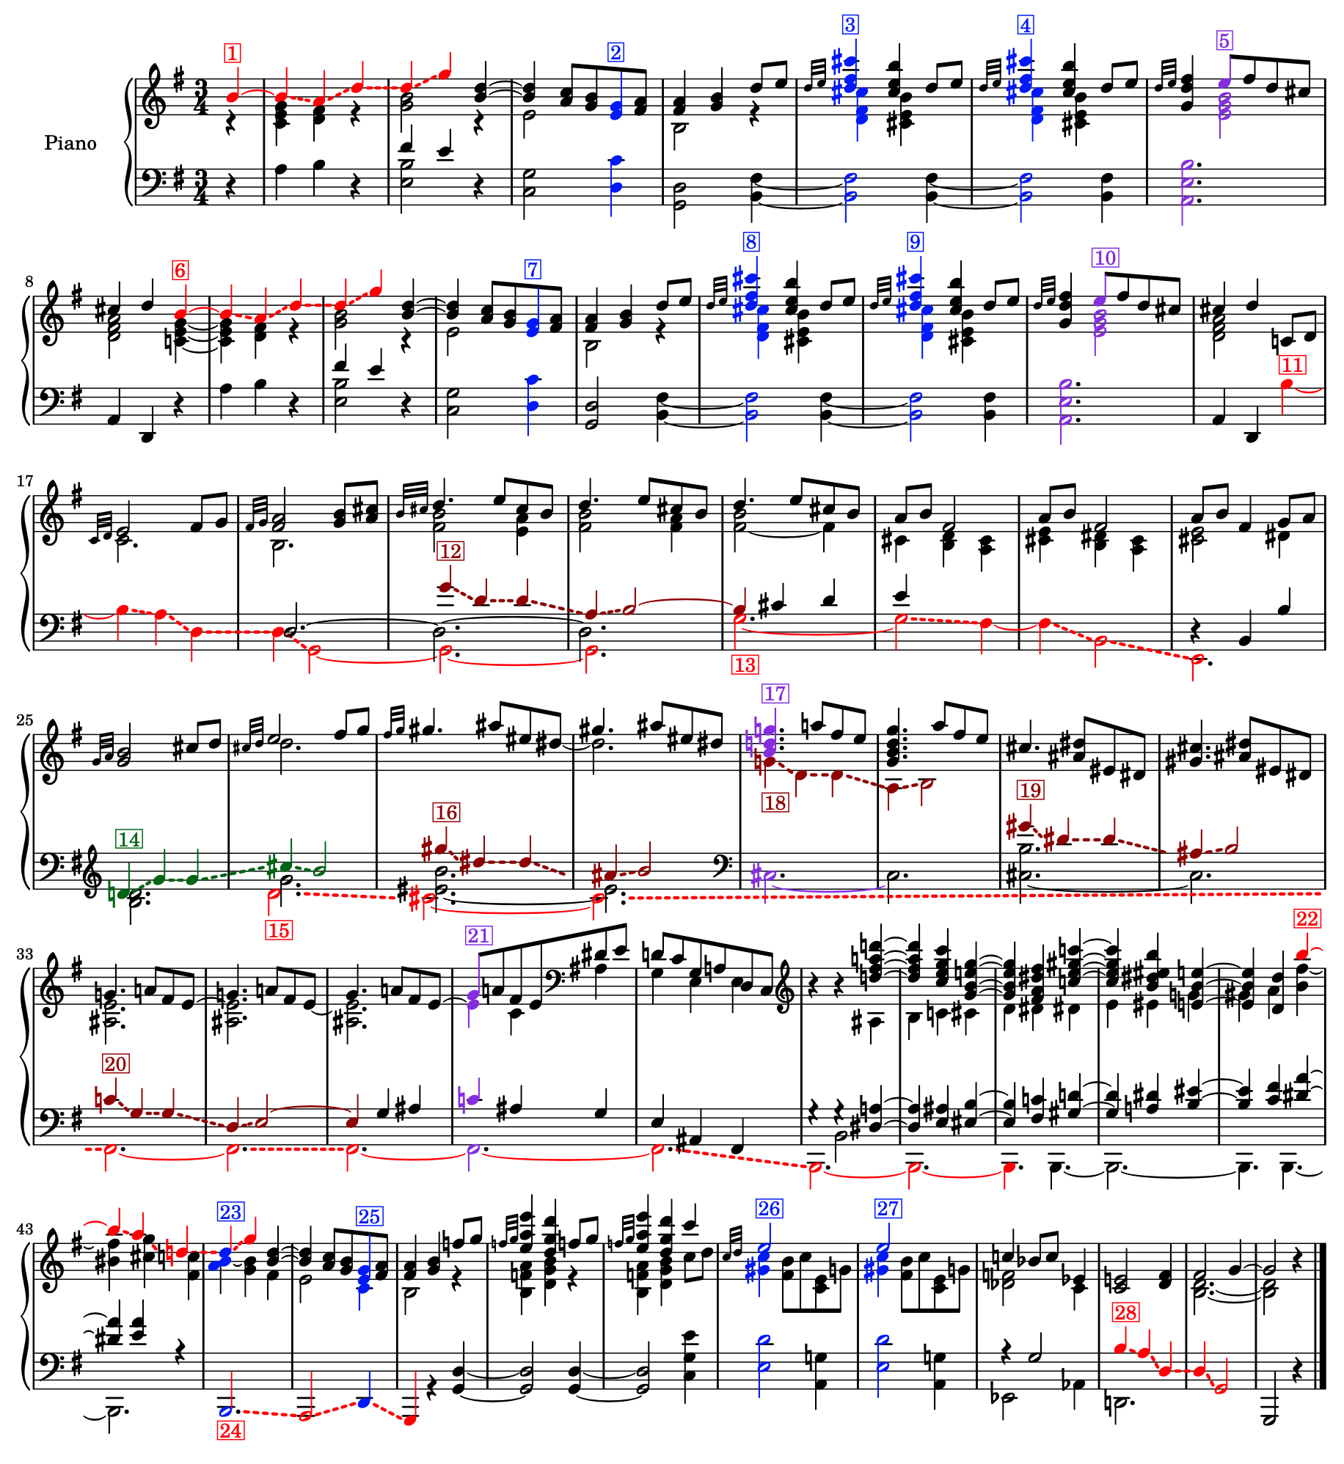
Soucy's (2009) analysis of Ravel's Menuet sur le nom d'Haydn
Ravel's contribution to the Hommage consisted of a short minuet, entitled Menuet sur le nom d'Haydn
In his masters thesis from the Schulich School of Music at McGill, Jean-Philippe Soucy presented a detailed analysis of all six pieces in the Hommage, in which he aims to identify every occurrence of the HAYDN theme in the pieces
The figure shows the 28 occurrences of the theme in Ravel's Menuet identified by Soucy
https://open.spotify.com/track/3Vcpv8QWJ3IPG9RYKFphoS?si=32ed40bc70464512

Slide 19
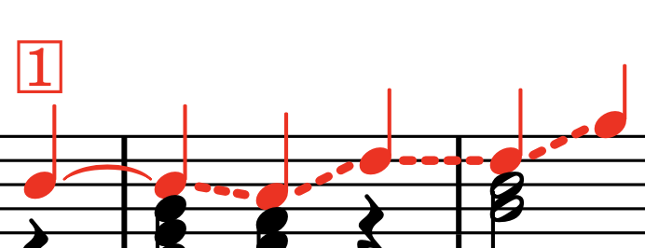
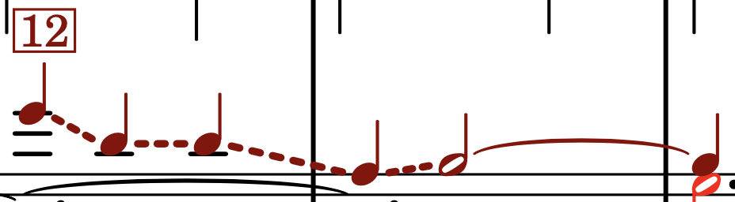
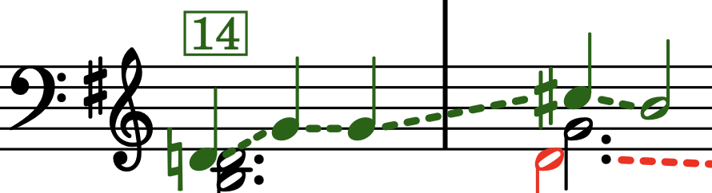
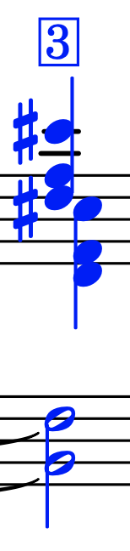

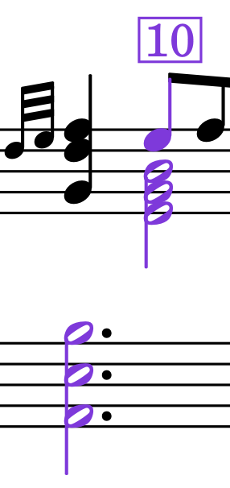
Transformed occurrences of the HAYDN theme in Ravel's Menuet, identified by Soucy
Melodic statements
Red: notes appear in original order, possibly transposed
Dark red: retrograde
Dark green: retrograde inversion
Chords
Blue: all notes played together to form an added ninth chord (without seventh)
Lilac: notes in inversion of theme played together to form an added fourth chord

Slide 20
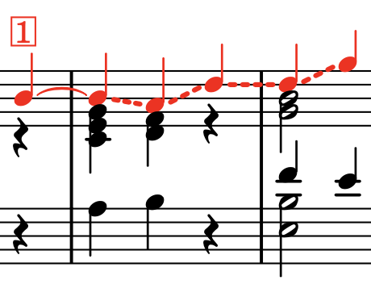
Occurrences identified by Soucy
None of the 28 occurrences of the HAYDN theme in Ravel's Menuet identified by Soucy are identical to the theme proposed by Écorcheville
Occurrences 1 and 6 extend the first note by a crotchet
The durations in the first occurrence are repeated exactly in 6, 14, 16, 18, 19 and 22

Slide 21
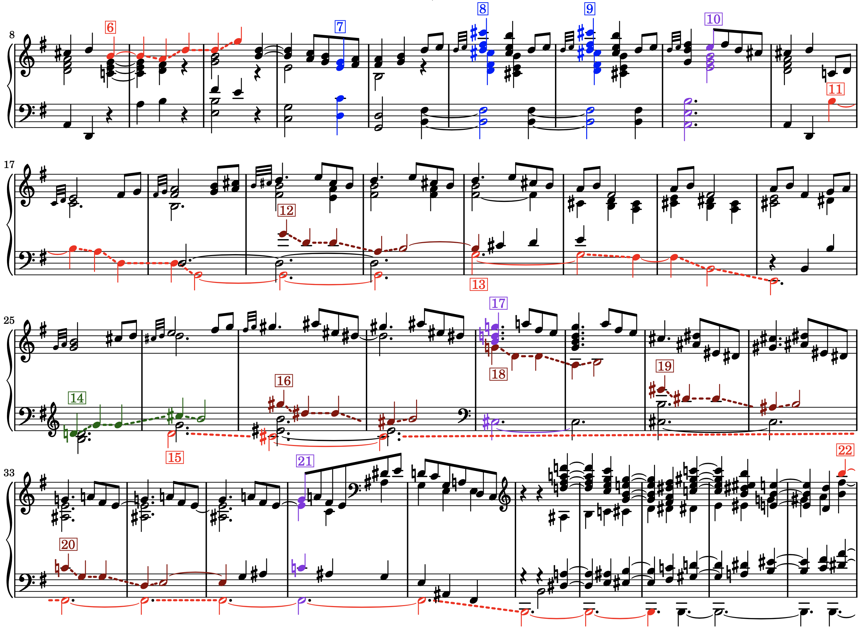
Occurrences identified by Soucy
In occurrences 11, 12 and 20, the final note is lengthened
In occurrences 13, 15 and 24, the note durations are augmented – especially occurrence 15 which has a four-bar gap in the middle
In occurrences 11, 13, 15, and 28, the rising fourths in the theme are inverted to become falling fifths
In occurrence 22, only the first fourth is inverted to become a fifth
Occurrences 13 and 24 each lack a note corresponding to the second D in the theme, so they are incomplete

Slide 22
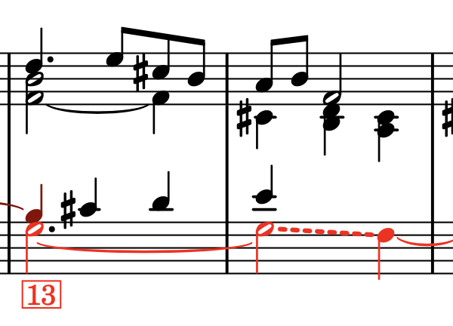
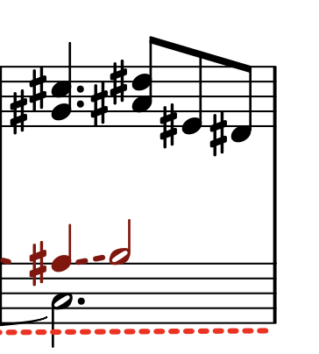
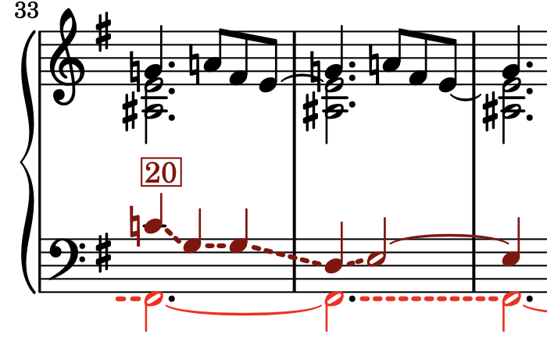
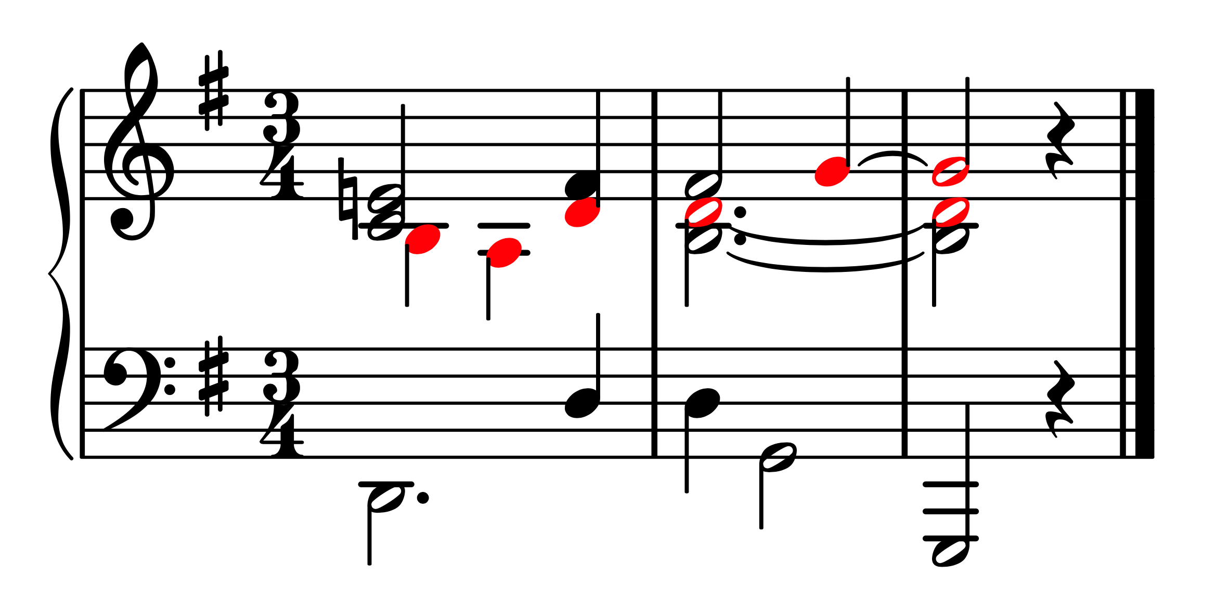
Issues with Soucy's analysis
Some of the occurrences identified by Soucy seem a bit spurious (e.g., 15 and the chordal occurrences)
He also misses out at least three occurrences that are as convincing as some of the ones he does identify (shown on the left)

Slide 23
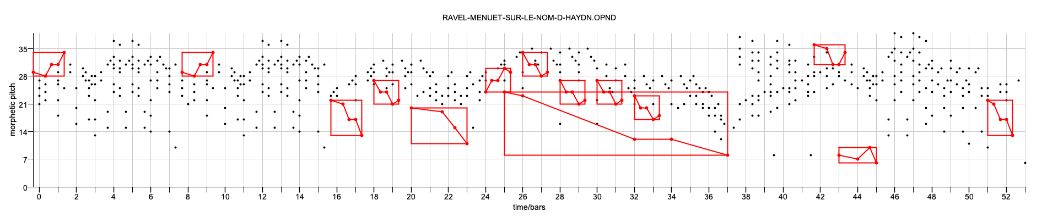
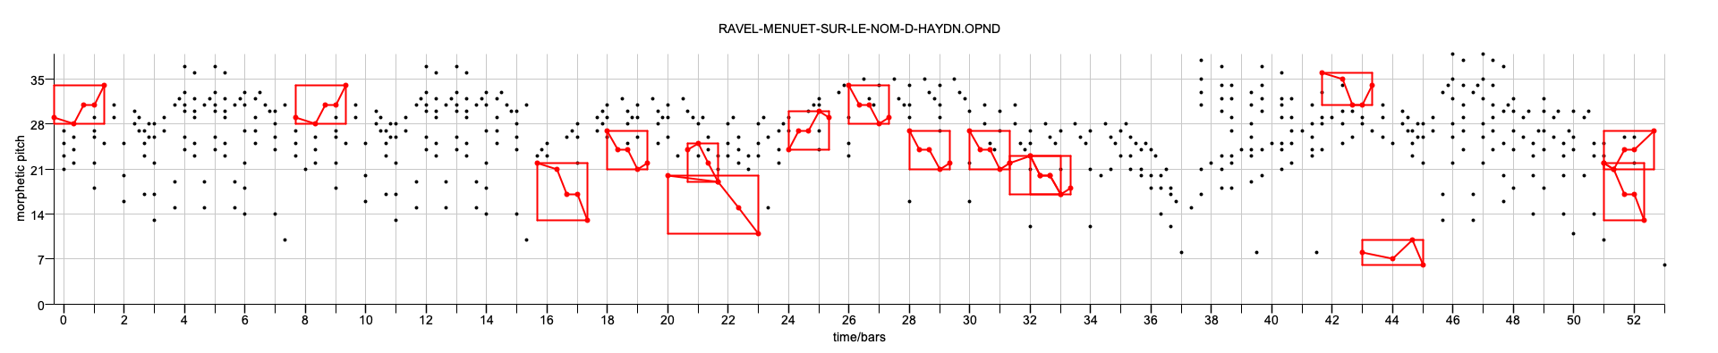
Ground truths for occurrences of the HAYDN theme in Ravel's Menuet
Soucy (modified)
Meredith
This gives us two "ground truths" for Ravel's Menuet

Slide 24
Ground truth for Bach's Contrapunctus VI from Die Kunst der Fuge
The ground truth for subject entries of Contrapunctus VI from Bach's Die Kunst der Fuge is less controversial
Here, occurrences (entries) of the subject are related to the first entry by combinations of augmentation, diminution and inversion

Slide 25
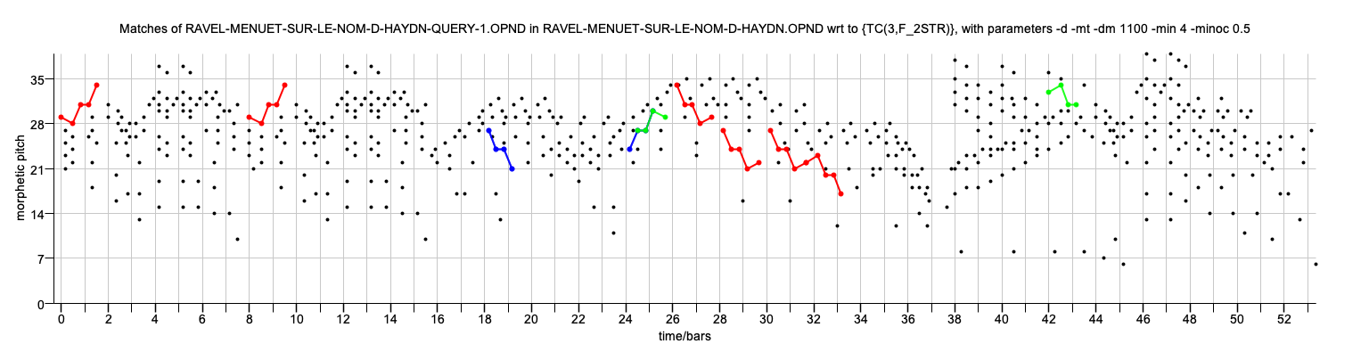
Results for Ravel with Meredith ground-truth
2-layer F1: 0.697
2-layer P: 0.911
2-layer R: 0.564

Slide 26
Results for Ravel with modified Soucy ground truth
2-layer F1: 0.698
2-layer P: 0.891
2-layer R: 0.573

Slide 27
Results for Bach, Contrapunctus VI
2-layer F1: 0.935
2-layer P: 0.949
2-layer R: 0.921

